Slide 1
Symbol Tables
anhtt-fit@mail.hut.edu.vn

Slide 2
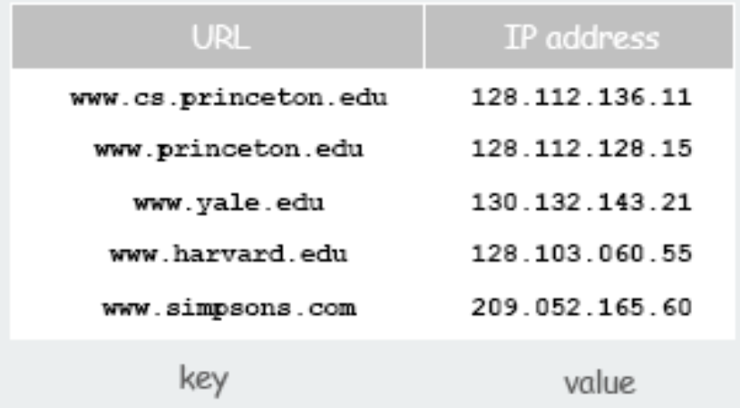
ADT
Key-value pair abstraction.
Insert a value with specified key.
Given a key, search for the corresponding value.
Example: DNS lookup.
Insert URL with specified IP address.
Given URL, find corresponding IP address
Can interchange roles: given IP address find corresponding URL

Slide 3
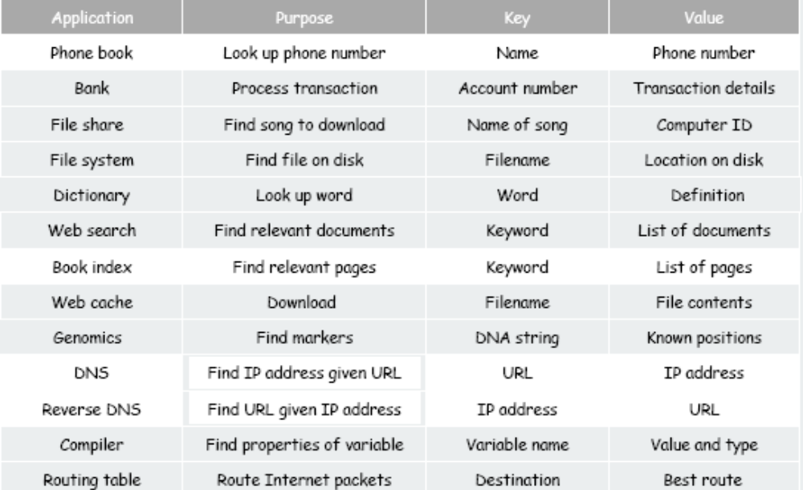
Example applications

Slide 4
Phone Book
Define a structure to store name and phone number pair. The key is name and the value is number.
typedef struct {
char name[80];
long number;
} PhoneEntry;

Slide 5
Using array for implementation
Key-value pairs are stored in an ordered array as the following
typedef struct {
PhoneEntry * entries;
int total;
int size;
} PhoneBook;
The memory to store the entries should be allocated dynamically according to the maximal size of the phone book.
When the total number of entries exceeds the maximal size, the memory have to be reallocated with a new maximal size

Slide 6
API
Let define two constant numbers to represent the initial size of a phone book and the gap size of the array each to time to be reallocated
#define INITIAL_SIZE 10
#define INCREMENTAL_SIZE 5
Write two functions to create a new phone book and drop the entries of a phone book as the following
PhoneBook createPhoneBook();
void dropPhoneBook(PhoneBook* book);

Slide 7
API
Add an entry in the phone book
void addPhoneNumber(char * name, long number, PhoneBook* book);
NB: If the entry exists, the value should be overwritten.
Find an entry in the phone book
PhoneEntry * getPhoneNumber(char * name, PhoneBook book);
returns null if the entry does not exist

Slide 8
Quiz 1
Complete the API specified for the phone book.
Write a phone book program using the given API

Slide 9
Solution
phonebook.c

Slide 10
Generic symbol tables
Define a generic structure for entries
typedef struct {
void * key;
void * value;
} Entry;
Define a generic structure for symbol tables
typedef struct {
Entry * entries;
int size, total;
Entry (*makeNode)(void*, void*);
int (*compare)(void*, void*);
} SymbolTable;
makeNode is a function pointer to refer to a function to create a node with a key and a value passed
compare is a function to refer to a function to compare two keys

Slide 11
API
#define INITIAL_SIZE 100
#define INCREMENTAL_SIZE 10
SymbolTable createSymbolTable(
Entry (*makeNode)(void*, void*),
int (*compare)(void*, void*)
);
void dropSymbolTable(SymbolTable* tab);
void addEntry(void* key, void* value, SymbolTable* book);
Entry* getEntry(void* key, SymbolTable book);
NB: Free the memory allocated for each entry when a table is dropped

Slide 12
Example
Entry makePhone(void* name, void* phone) {
Entry res;
res.key = strdup( (char*)name );
res.value = malloc(sizeof(long));
memcpy( res.value, phone, sizeof(long) );
return res;
}
int comparePhone(void * key1, void* key2) {
return strcmp((char*)key1, (char*)key2);
}
SymbolTable phoneBook = createSymbolTable(makePhone, comparePhone);
long number = 983984775;
char name[] = “Ta Tuan Anh”;
addEntry(name, &number, &phoneBook);

Slide 13
Quiz 2
Rewrite the phone book program using the generic symbol table

Slide 14
Solution
phonebook_generic.c

